Slide 1
Course Name: Database Systems Course Code: CS52 Credits: 3:1:0 UNIT 4 Term: Oct 2021 – Feb 2022
M.S. Ramaiah Institute of Technology
(Autonomous Institute, Affiliated to VTU)
Department of Computer Science and Engineering
Faculty:
Dr. Sini Anna Alex

Slide 2
3 Normal Forms Based on Primary Keys
Normalization of Relations
Practical Use of Normal Forms
Definitions of Keys and Attributes Participating in Keys
First Normal Form
Second Normal Form
Third Normal Form

Slide 3
Definitions of Keys and Attributes Participating in Keys
A superkey of a relation schema R = {A1, A2, ...., An} is a set of attributes S subset-of R with the property that no two tuples t1 and t2 in any legal relation state r of R will have t1[S] = t2[S]
A key K is a superkey with the additional property that removal of any attribute from K will cause K not to be a superkey any more.

Slide 4
Definitions of Keys and Attributes Participating in Keys
If a relation schema has more than one key, each is called a candidate key.
One of the candidate keys is arbitrarily designated to be the primary key, and the others are called secondary keys.
A Prime attribute must be a member of some candidate key
A Nonprime attribute is not a prime attribute—that is, it is not a member of any candidate key.

Slide 5
Finding Candidate Keys and Super Keys of a Relation using FD set
The set of attributes whose attribute closure is set of all attributes of relation is called super key of relation.
Consider the following FD set. {E-ID->E-NAME, E-ID->E-CITY, E-ID->E-STATE, E-CITY->E-STATE}
Let us calculate attribute closure of different set of attributes: EMPLOYEE(E-ID, E-NAME, E-CITY, E-STATE)
(E-ID)+ = {E-ID, E-NAME,E-CITY,E-STATE}
(E-ID,E-NAME)+ = {E-ID, E-NAME,E-CITY,E-STATE}
(E-ID,E-CITY)+ = {E-ID, E-NAME,E-CITY,E-STATE}
(E-ID,E-STATE)+ = {E-ID, E-NAME,E-CITY,E-STATE}
(E-ID,E-CITY,E-STATE)+ = {E-ID, E-NAME,E-CITY,E-STATE}
(E-NAME)+ = {E-NAME}
(E-CITY)+ = {E-CITY,E-STATE}

Slide 6
Normalization of Relations
Normalization:
The process of decomposing unsatisfactory "bad" relations by breaking up their attributes into smaller relations.
It is important that a database is normalized to minimize redundancy (duplicate data) and to ensure only related data is stored in each table.
Normalization makes sure that all of your data looks and reads the same way across all records.
The benefits of normalization include: Searching, sorting, and creating indexes is faster
Normal form:
Condition using keys and FDs of a relation to certify whether a relation schema is in a particular normal form

Slide 7
Normalization of Relations
2NF, 3NF, BCNF
based on keys and FDs of a relation schema
4NF
based on keys, multi-valued dependencies : MVDs;
5NF
based on keys, join dependencies : JDs
Additional properties may be needed to ensure a good relational design (lossless join, dependency preservation)

Slide 8
Practical Use of Normal Forms
Normalization is carried out in practice so that the resulting designs are of high quality and meet the desirable properties
The practical utility of these normal forms becomes questionable when the constraints on which they are based are hard to understand or to detect
The database designers need not normalize to the highest possible normal form
(usually up to 3NF and BCNF. 4NF rarely used in practice.)
Denormalization:
The process of storing the join of higher normal form relations as a base relation—which is in a lower normal form

Slide 9
First Normal Form
Disallows
composite attributes
multivalued attributes
nested relations; attributes whose values for an individual tuple are non-atomic
Considered to be part of the definition of relation .
Most RDBMSs allow only those relations to be defined that are in First Normal Form

Slide 10
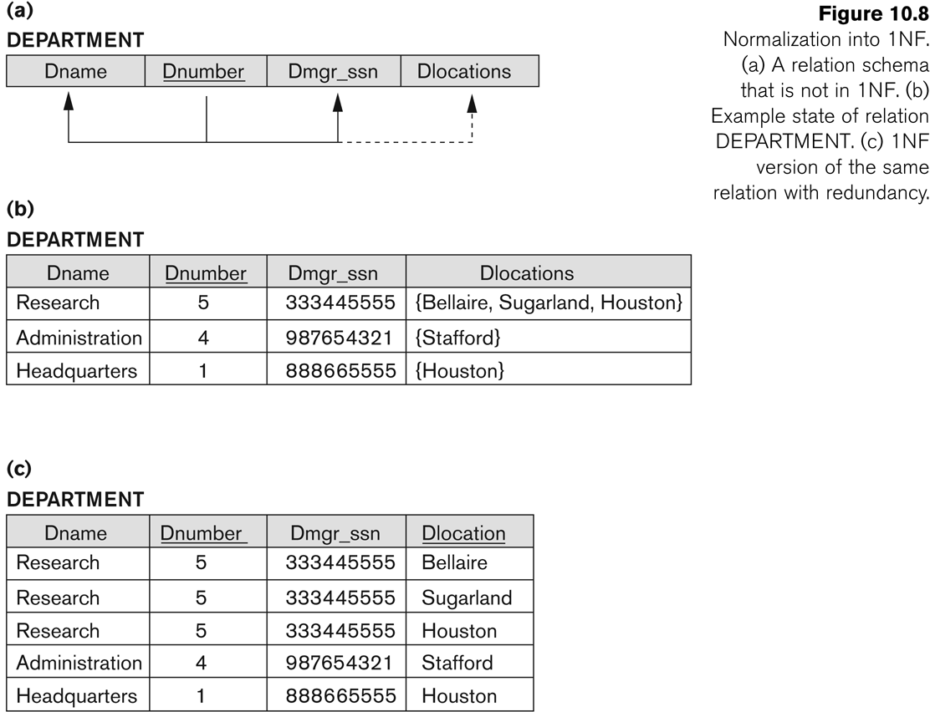
Normalization into 1NF

Slide 11
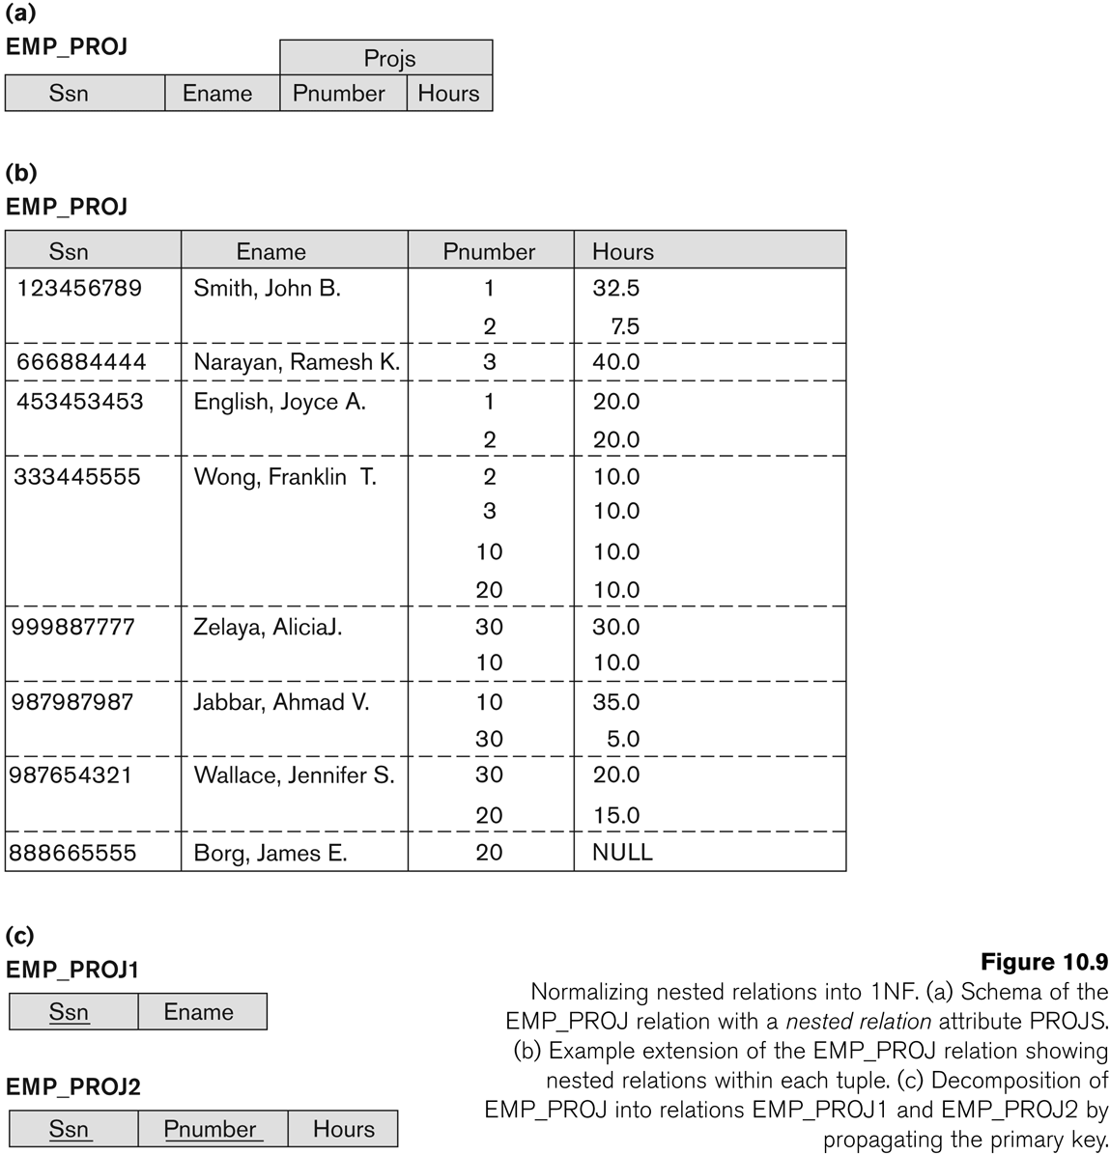
Normalization nested relations into 1NF

Slide 12
Second Normal Form
Second normal form (2NF) is based on the concept of full functional dependency. A functional dependency X 🡪 Y is a full functional dependency if removal of any attribute A from X means that the dependency does not hold any more.
Functional dependency X 🡪 Y is a partial dependency if some attribute A ϵ X can be removed from X and the dependency still holds.

Slide 13
Second Normal Form contd………
A relation schema R is in second normal form (2NF) if every non-prime attribute A in R is fully functionally dependent on the primary key
R can be decomposed into 2NF relations via the process of 2NF normalization or “second normalization”

Slide 14
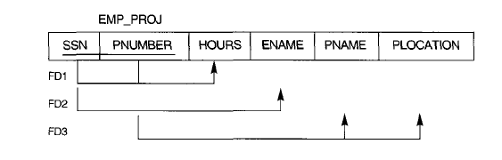

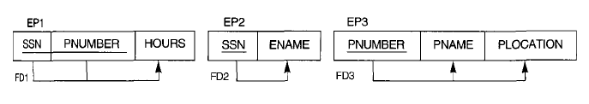
2NF Example
Key: SSN, PNUMBER
FDs:
SSN, PNUMBER-> HOURS
SSN->ENAME
PNUMBER->PNAME
PNUMBER->PLOCATION

Slide 15
Tutorial 2: Decompose a non-2NF relation to a 2NF relation
Assume a relation R (A, B, C, D, E) with the following set of functional dependencies;
F = {AB → C, B → D, E → D}
The key for this relation is ABE. Then, all three given FDs are partial dependencies, viz., AB → C, B → D, and E → D.
Step 1: separate tables for partial dependencies; hence, R1 (ABC), R2 (BD) and R3 (ED).
Step 2: remove RHS of these two partial FDs from R; hence, R4(A, B, E).
Thus, we have four tables R1 (ABC), R2 (BD), R3 (ED) and R4 (ABE).

Slide 16
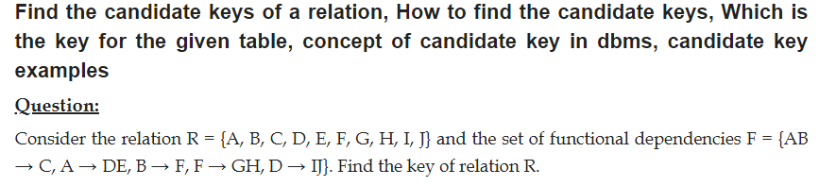
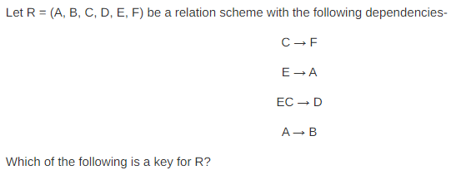

Slide 17
Tutorial 4: Compute Minimal Cover
1. Find the minimal cover of the set of functional dependencies given;
{A → C, AB → C, C → DI, CD → I, EC → AB, EI → C}
2. F = { AB -> C, C -> A, BC -> D, ACD -> B, D -> E, D -> G, BE -> C, CG -> B, CG -> D, CE -> A, CE -> G}
Solution:
Q1: MC = {A → C, C → D, C → I, EC → A, EC → B, EI → C}
Q2:
Minimal Cover 1: {AB -> C, C -> A, BC -> D, CD -> B, D -> E, D -> G, BE -> C, CG -> D, CE -> G}
---------------------------------------------------------------------------------------------------------
Minimal Cover 2 : {AB -> C, C -> A, BC -> D, D -> E, D -> G, BE -> C, CG -> B, CE -> G}

Slide 18
Thank you

